Slide 1

Git Workflows
A Quick overview of Git Workflows and Which one to Pick

Slide 2
Workflow
A workflow is a process through which a software can be developed, packaged, tested and released.
A workflow defines stages in which a software passes from development to end user.

Slide 3
Brief Overview
Name of workflow | Branches
Centralized Control | Master
GITHub Flow / Feature Branch | Master, Features
GITFlow | Master, Develop, Release, HotFix, Feature
ProGIT | Master, Develop, Feature
Forking | Master, Feature
SkullCandy | Master, Feature, QA

Slide 4
Centralized
Central Repository
Local Repository
Clone
Working Directory
Pull -rebase
Git status
Git add
Git commit
Master branch
Master branch
Push

Slide 5
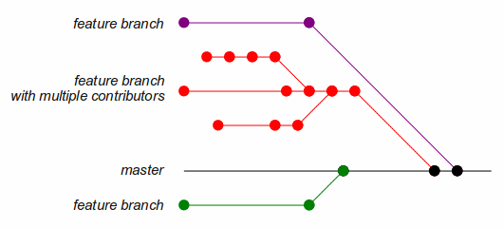
GitHub Flow

Slide 6
GitHub Flow
Provides flexibility for individual feature development
Protects master branch
Promotes teamwork
Enforces reviews before merger
Quicker response to issues
Shorter release time
Isolation of each task
Disadvantages:
Too flexible
Allows ad-hoc branch creation and duplication

Slide 7
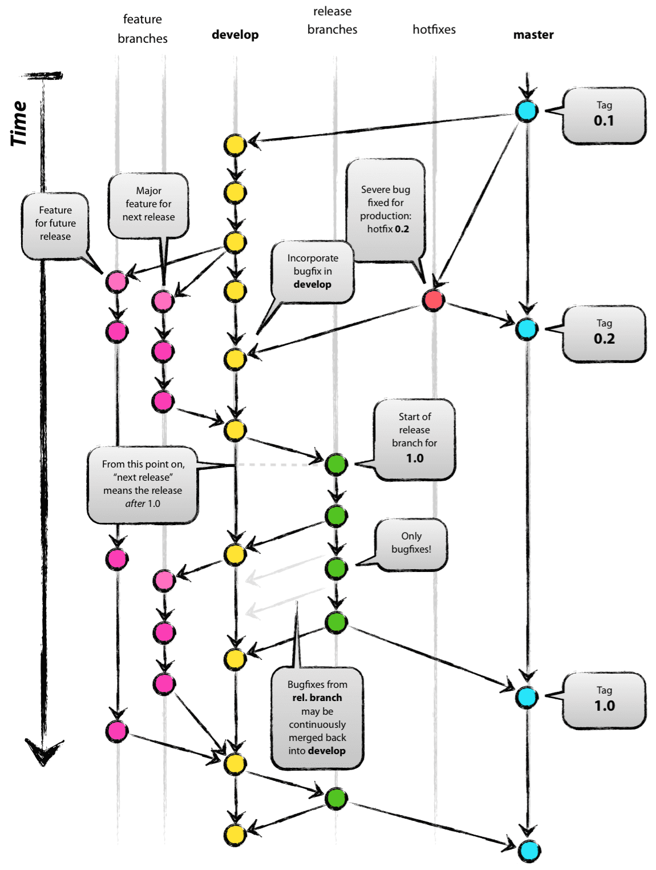
Git Flow

Slide 8
Git Flow
Master branch is always production-ready
Lowers risks for large-scale projects
Continuous and concurrent development of features possible
Issues can be fixed without a new release cycle
Disadvantages:
Fixes must be applied on both master and developer branches
Longer release cycle
Too complicated for early adopters

Slide 9
Pro Git
Central Repository
Local Repository
My Feature
Master
Develop
My Feature
git checkout –b myFeature Master
Working Directory
test
test
push
Git status
Git add
Git commit

Slide 10
Pro Git
Github flow with reduced complexity.
Master branch is protected.
Easy for beginners.
Two stage testing.
Disadvantages:
No staging or release branch
Development branch is confused with master branch.
Feature branches are fully controlled by developer.

Slide 11
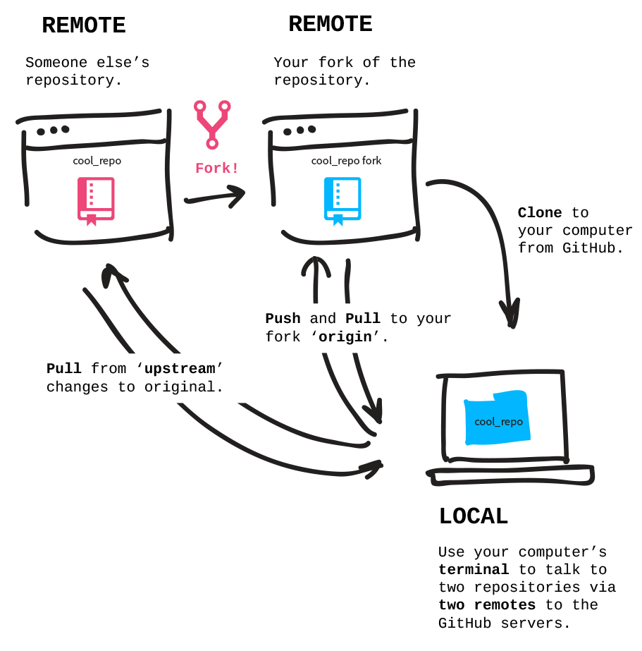
Forking

Slide 12
Forking
Highly specific to Github.
Usually used when extending an existing repository for custom development.
Allows development of two independent versions of a software.
Some features may never be merged into origin.
Code is pushed to forked copy rather than the origin.
Disadvantages:
Highly difficult to synchronize with origin repository.
Strictly enforces PR mechanism.

Slide 13
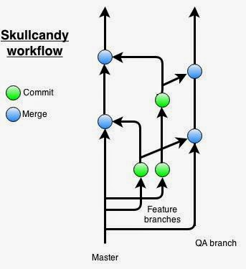
Skull Candy

Slide 14
Skull Candy
Works in Sprints with pre-planned release.
QA (staging) branch created from master.
Code is pushed from Feature branch into QA.
Upon approval from QA, code is merged into master.
Deployments are with respect to timeline rather than feature readiness.
Disadvantages:
Made for Agile development only.
No separate release branch.

Slide 15
TechThree Flow
Proposal:
Extend Skull Candy with some customization.
Feature > Master > Staging > Production.
No branch is ever deleted.
Feature branches are named after ticket on Asana.
Feature branches are created during Sprint meeting.
Merger from Feature into Master after code review.
Merger from Master to Staging after QA process.
Merger from Staging to Production at the end of Sprint.

Slide 16
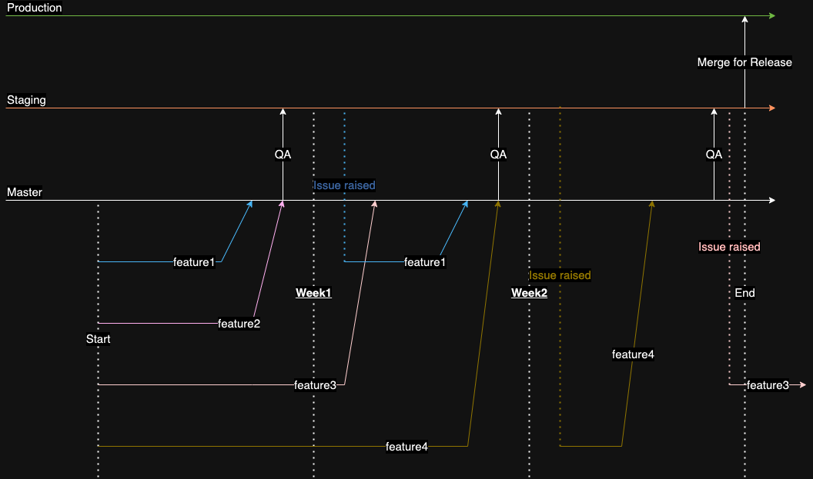

Slide 17
Things to Remember!
Once the QA starts smoke testing (1 day before release), no more features can be merged into staging.
If one feature B requires completion of feature A, then B cannot be selected in active sprint.
Code is merged into production only once per sprint.
No new features can be added in the middle of the sprint.
Only QA lead has the authority to hold a release.
Mergers into Staging and Production will be automated.
As the code is merged into Production, Release notes will be prepared directly from Asana.
Each release will be tagged by its version.

